Slide 1
Gesture-based Robot Control
COURSE: ROB202-INTRODUCTION TO ROBOTICS Lab
Teachers: Dr. Shugata ahmed, lecturer, rme
Abhishek Kumar Ghosh, lecturer, RME
Group 3
Raiyaan Abdullah (AE-092-004)
Md. Abdullah Al Noman (SH-092-014)
Swakshar Deb (JH-092-017)
Ahsan Imran (AE-092-018)
Abdullah Al Mamun (FH-092-031)

Slide 2
Overview of the project
In this project, we will control a mobile robot through the use of hand gestures. It compromises of mainly a bot and a handglove with necessary circuitry.
The bot will move forward or backward, or rotate left or right according to the direction we incline our hand.
This will be achieved through the communication of two HC-05 Bluetooth modules which are configured as master and slave. The degree of inclination of the hand will be detected by MPU-6050 sensor which contains an MEMS accelerometer. Arduino nano boards are used as the microcontrollers.

Slide 3
Application of gesture-based controls
These robots are used in military applications to operate robots.
These robots are used in medical applications for the purpose of surgery.
These robotics are used in the construction field.
These robotics are used in industries to control trolly and lift.
Overall, it is suitable for situations where it is tough to control the robot using a complex command interface.

Slide 4
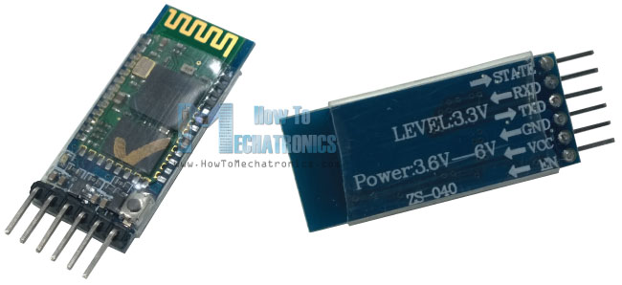
Pairing two Bluetooths
The model of the Bluetooth modules used in this project is HC-05. We need to pair two of these as master and slave. This is achieved by entering the AT command mode.

Slide 5
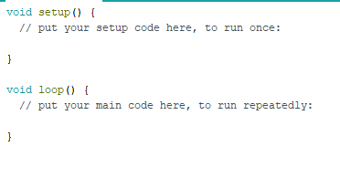
AT Command
We can change certain properties of the Bluetooth module once we enter AT command. In order to enter AT Command, first we upload the following blank code to Arduino Nano:

Slide 6
AT Command
We can change certain properties of the Bluetooth module once we enter AT command. In order to enter AT Command, first we upload the following blank code to Arduino Nano:

Slide 7
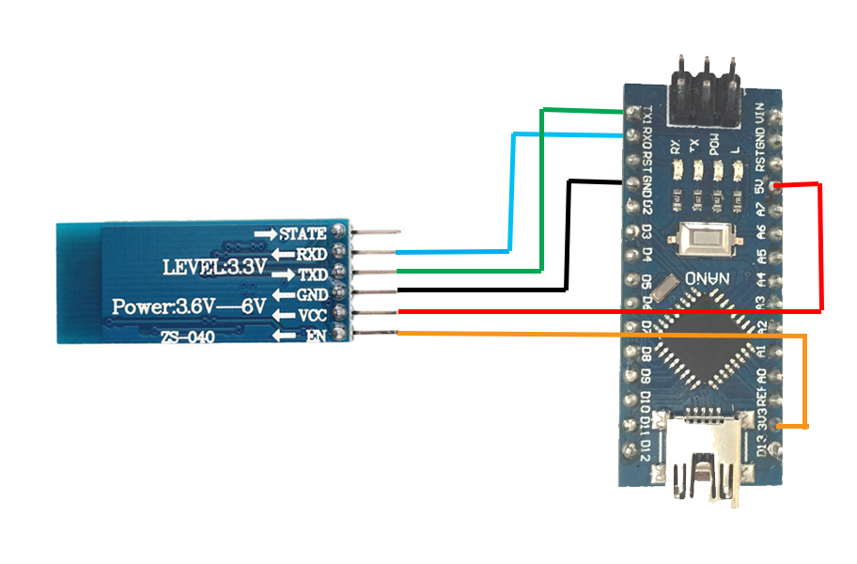
AT Command
Then we establish the following connections between Bluetooth and Arduino Nano:
(Arduino Nano -> Bluetooth)
RX -> RX
TX -> TX
GND -> GND
+5V -> VCC
+3.3V -> EN

Slide 8
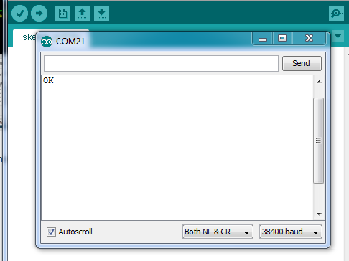
AT Command
Then selecting the necessary COM port we open the serial monitor in Arduino IDE and type AT. It is to be noted that baud rate is 38400 and “Both NL & CR” is selected. If the returned message is “OK” then we have successfully entered the AT command mode.

Slide 9
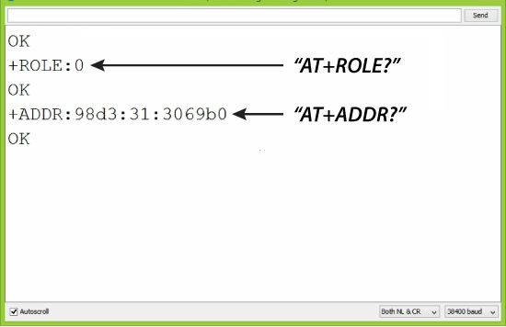
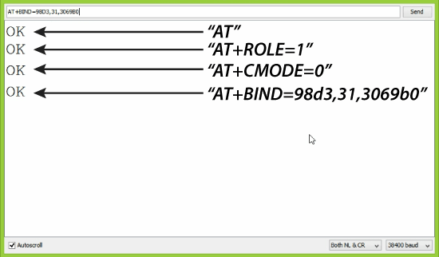
Configuring the master and slave
Once we are inside the AT Command, the following commands need to be entered.
Slave
The Bluetooth acts as slave in default. We need to know the address
of the slave module.
And thus the bluetooths are paired and ready for use.
Master
Once we enter the address of the slave. We need to bind the master and slave using the address by the following commands:

Slide 10
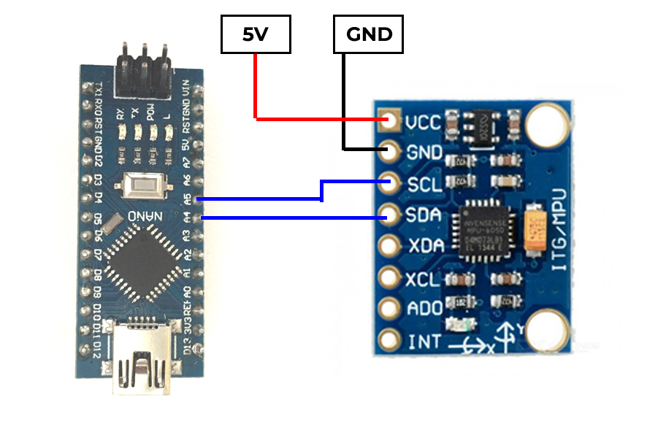
MPU 6050
We need to establish the following connections between MPU6050 and Arduino Nano, the communite using the I2C bus which comprises of the pins SDA (Serial Data) and SCL (Serial Clock):
(Arduino Nano -> MPU6050)
A4 -> SDA
A5 -> SCA
We connect the VCC and GND from the common paths.

Slide 11
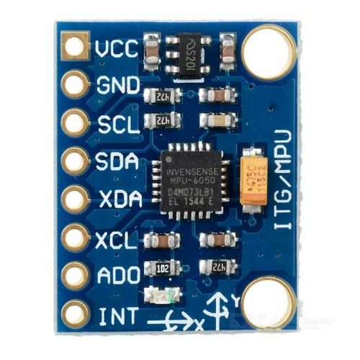
MPU 6050 connection
The MPU-6050 is the world’s first integrated 6-axis MotionTracking device
It combines a 3-axis gyroscope, 3-axis accelerometer, and a Digital Motion Processor™ (DMP) all in a small 4x4x0.9mm package.
It uses a standard I2C bus for data transmission. With it’s I2C bus, it can accepts inputs from an external 3-axis compass to provide a complete 9-axis MotionFusion output.

Slide 12
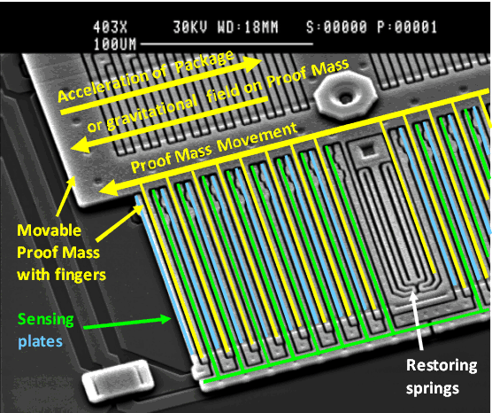
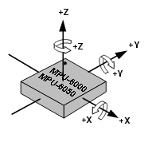
Accelerometers
We will be using the accelerometer of the MPU6050.
Proof mass deflection is measured as a change in capacitance between the proof mass and sensing plates
Internal circuitry converts the tiny capacitance to a voltage signal which is digitized and output
Each accelerometer has a zero-g voltage level, you can find it in spec
Accelerometers also have a sensitivity, usually expressed in mV/g
Divide the zero-g level corrected reading by the sensitivity to produce the final reading

Slide 13
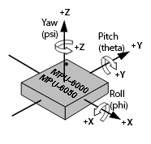
Accelerometers
Computing orientation from an accelerometer relies on a constant gravitational pull of 1g (9.8 m/s^2) downwards
If no additional forces act on the accelerometer (a risky assumption), the magnitude of the acceleration is 1g, and the sensor’s rotation can be computed from the position of the acceleration vector
If the Z-axis is aligned along the gravitational acceleration vector, it is impossible to compute rotation around the Z-axis from the accelerometer.
Digital accelerometers give information using a serial protocol like I2C , SPI or USART; analog accelerometers output a voltage level within a predefined range

Slide 14
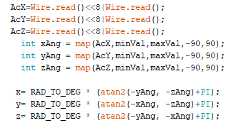
Accelerometers
In Arduino we use the Wire.h library to get the Accelerometer readings of the MPU 6050. The values are read as 8 bytes. They have a minVal of 265 and maxVal of 402. They are mapped to be between -90 and 90. The atan2(x,y) function computes the arctangent of the negative values of and returns the value in the range [-pi, +pi] radians. We add Pi to the values to make them positive and convert them back to degrees. This is how we get the angle of orientation of hand.

Slide 15
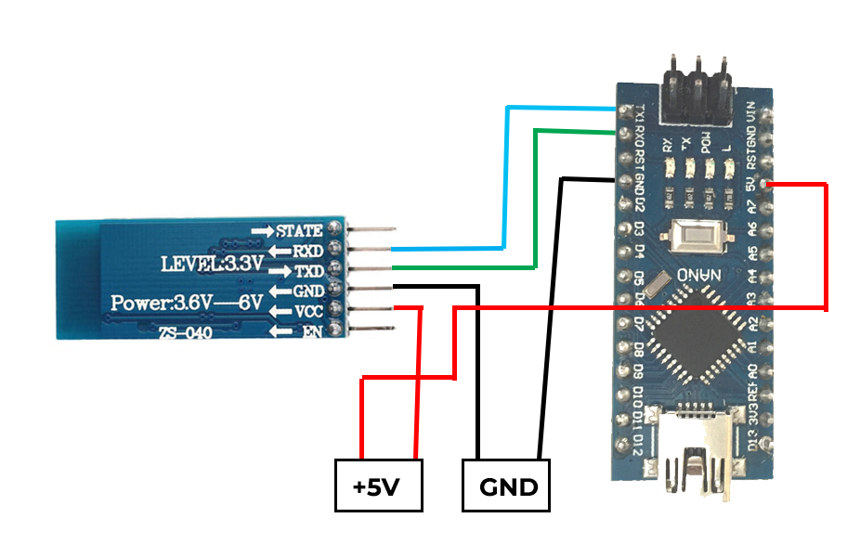
Data communication between Bluetooth and Arduino
First we need to the connect the Bluetooth and Arduino Nano:
(Arduino Nano -> Bluetooth)
TX -> RX
RX -> TX
Both will be powered from the common +5V and GND paths.

Slide 16

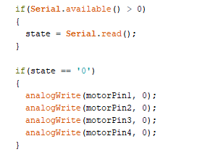
Data communication between Bluetooth and Arduino
Communication between Bluetooth and Arduino happens using the Serial monitor in 38400 baud rate.
Master The Arduino Nano attached to the master module simply measures the angle from MPU6050 and sends a corresponding data using Serial.write() command.
Slave The Arduino Nano attached to the slave module checks if the serial data is available using Serial.available() and reads using Serial.read()

Slide 17
Motor Commands
The Slave Bluetooth will take the corresponding serial data of the angle from the Master and give it to the Arduino Nano. The Arduino Nano will generate motor commands according to the data. So the bot will move.

Slide 18
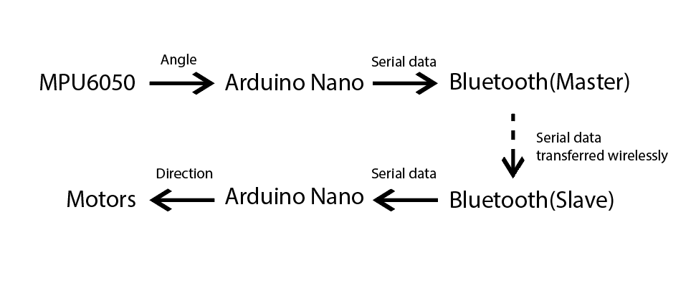
Overall flow chart

Slide 19
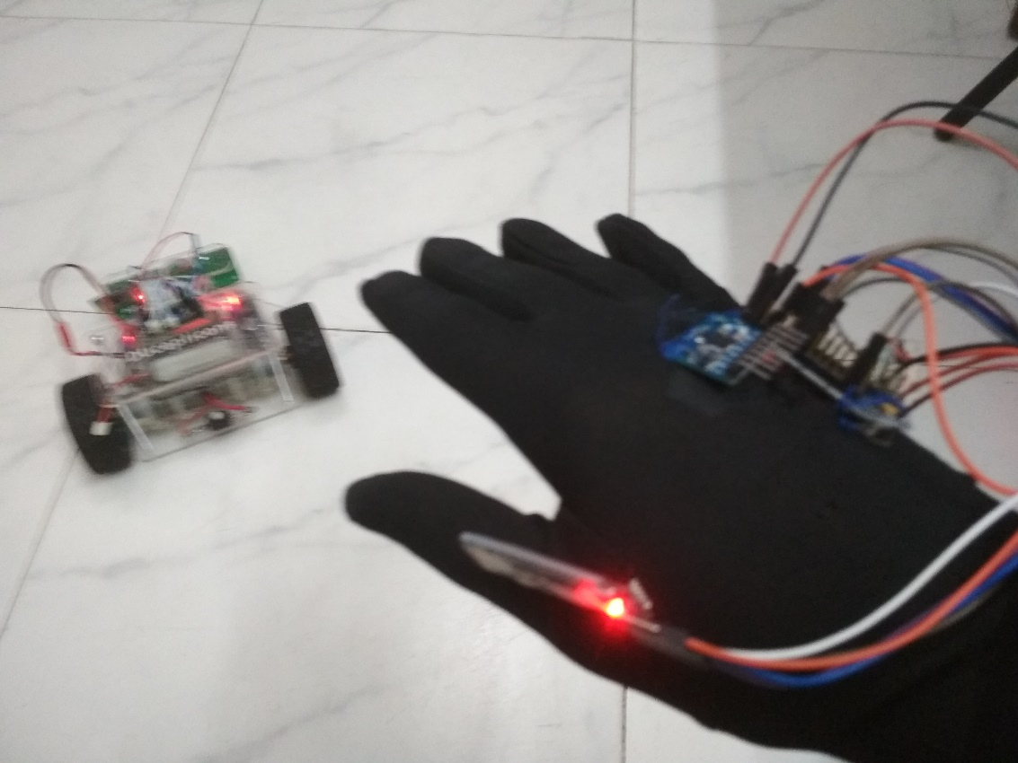
THANK YOU FOR LISTENING

